Slide 1



AcF 304 Financial Markets
Bond Markets 1:
Term Structure of Interest Rates (part 1)
FM&I Chapter 5
Notes:
If this PowerPoint presentation contains mathematical equations, you may need to check that your computer has the following installed:
1) MathType Plugin
2) Math Player (free versions available)
3) NVDA Reader (free versions available)

Slide 2
Topic Preview (1 of 4)
Regarding interest rates and interest rate movements, it could be implied there is only one economy-wide interest rate. That is a big assumption and isn’t really the case.
In this topic, we will examine the different rates that we observe for financial products.

Slide 3
Topic Preview (2 of 4)
We will fist examine bonds that offer similar payment streams but differ in price. The price differences are due to the risk structure of interest rates. We will examine in detail what this risk structure looks like and ways to examine it.

Slide 4
Topic Preview (3 of 4)
Next, we will look at the different rates required on bonds with different maturities. That is, we typically observe higher rates on longer-term bonds. This is known as the term structure of interest rates. To study this, we usually look at Treasury bonds to minimise the impact of other risk factors.

Slide 5
Topic Preview (4 of 4)
So, in sum, we will examine how the individual risk of a bond affects its required rate. We also explore how the general level of interest rates varies with the maturity of the debt instruments. Topics include:
Risk Structure of Interest Rates
Term Structure of Interest Rates

Slide 6
Risk Structure of Interest Rates
To start this discussion, we first examine the yields for several categories of long-term bonds over the last 90 years.
You should note several aspects regarding these rates, related to different bond categories and how this has changed through time.

Slide 7
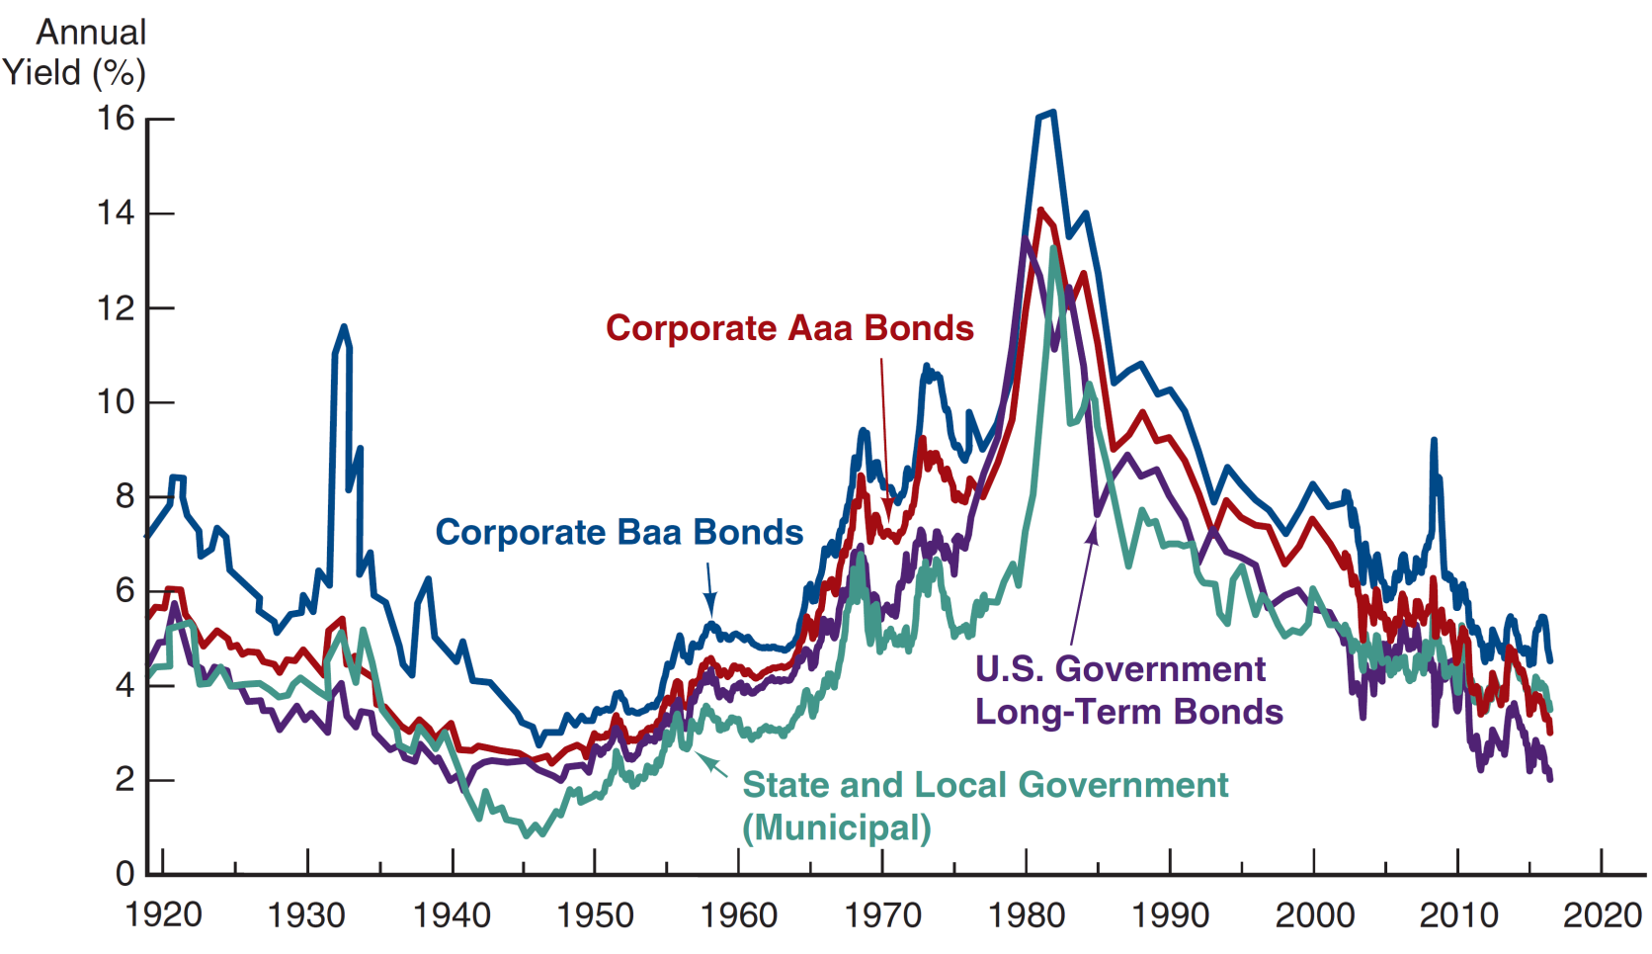
Figure 5.1 Long-Term Bond Yields, 1919–2016
Sources: Board of Governors of the Federal Reserve System, Banking and Monetary Statistics, 1941–1970; Federal Reserve Bank of St. Louis FRED database, https://fred.stlouisfed.org/series/GS10, https://fred.stlouisfed.org/series/AAA, https://fred.stlouisfed.org/series/BAA.

Slide 8
Risk Structure of Long Bonds in the U.S.
The figure shows two important features of the interest-rate behavior of bonds.
Interest rates on different types of bonds differ from one another in any given year.
The spread (or difference) between the interest rates varies over time.

Slide 9
Factors Affecting Risk Structure of Interest Rates
To further examine these features, we will look at three specific risk factors.
Default Risk
Liquidity
Income Tax Considerations (Briefly)

Slide 10
Default Risk
One attribute of a bond that influences its interest rate is its risk of default, which occurs when the issuer of the bond is unable or unwilling to make interest payments when promised.

Slide 11
Default Risk
U.S. Treasury bonds have usually been considered to have no default risk because the federal government can always increase taxes to pay off its obligations (or just print money). Bonds like these with no default risk are called default-free bonds.

Slide 12
Default Risk
But are these bonds truly default-free bonds? During the budget negotiations in Congress in 1995–1996, and then again in 2011–2013, the Republicans threatened to let Treasury bonds default, and this had an impact on the bond market. If these bonds were truly “default-free,” we should not have seen any reaction.

Slide 13
Default Risk
The spread between the interest rates on bonds with default risk and default-free bonds, called the risk premium, indicates how much additional interest people must earn in order to be willing to hold that risky bond.
A bond with default risk will always have a positive risk premium, and an increase in its default risk will raise the risk premium.

Slide 14
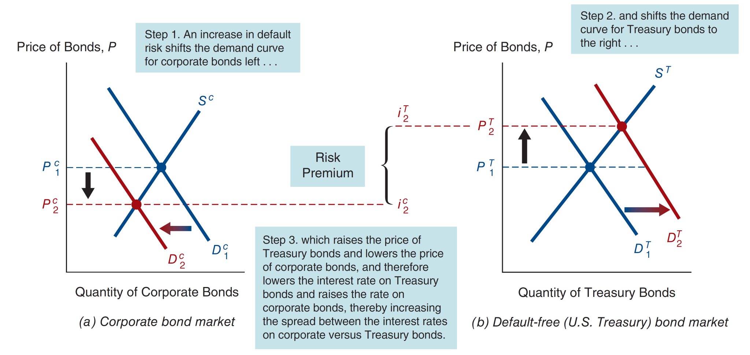
Figure 5.2 Response to an Increase in Default Risk on Corporate Bonds

Slide 15
Default Risk
Default risk is an important component of the size of the risk premium.
Because of this, bond investors would like to know as much as possible about the default probability of a bond.
One way to do this is to use the measures provided by credit-rating agencies: Moody’s,Standard & Poors and Fitch are main firms.

Slide 16
Table 5.1 Bond Ratings by Moody’s and Standard and Poor’s
Moody’s Rating | S&P Rating | Description | Examples of Corporations with Bonds Outstanding in 2016
Aaa | AAA | Highest quality (lowest default risk) | Microsoft, J&J
Aa | AA | High quality | Apple, General Electric
A | A | Upper-medium grade | MetLife, Intel, Harley-Davidson
Baa | BBB | Medium grade | McDonalds, BofA, HP, FedEx, Southwest Airlines
Ba | BB | Lower-medium grade | Best Buy, American Airlines, Delta Airlines, United Airlines
B | B | Speculative | Netflix, Rite Aid, J.C. Penney
Caa | CCC,CC | Poor (high default risk) | Sears, Elizabeth Arden
C | D | Highly speculative | Halcon Resources, Seventy-Seven Energy
BBB & above = investment grade
Below = ‘Junk’/High Yield

Slide 17
Figure 5.1 Long-Term Bond Yields, 1919–2016
Sources: Board of Governors of the Federal Reserve System, Banking and Monetary Statistics, 1941–1970; Federal Reserve Bank of St. Louis FRED database, https://fred.stlouisfed.org/series/GS10, https://fred.stlouisfed.org/series/AAA, https://fred.stlouisfed.org/series/BAA.

Slide 18
Liquidity Factor
Another attribute of a bond that influences its interest rate is its liquidity; a liquid asset is one that can be quickly and cheaply converted into cash if the need arises. The more liquid an asset is, the more desirable it is (higher demand), holding everything else constant.

Slide 19
Liquidity Factor
The differences between interest rates on corporate bonds and Treasury bonds (that is, the risk premiums) reflect not only the corporate bond’s default risk but its liquidity too. This is why a risk premium is sometimes called a risk and liquidity premium.

Slide 20
Liquidity Risk
Risk that the investor will have to sell the bond below its market value (revealed by a recent transaction or indicated on trading screens)
The primary measure of liquidity is the size of the bid-ask spread: difference between the ask price and the bid price (Note: European market use the term Offer not Ask)
Ask/Offer price: price at which the dealer is willing to sell a security
Bid price: price at which the dealer is willing to buy a security
A liquid market has a small bid-ask spread which does not increase materially for large transactions

Slide 21
Income Taxes Factor
An odd feature of Figure 5.1 is that municipal bonds tend to have a lower rate the Treasuries. Why?
Munis certainly can default. Orange County (California) is a recent example from the early 1990s.
Munis are not as liquid a Treasuries.

Slide 22
Income Taxes Factor
However, interest payments on municipal bonds are exempt from federal income taxes, a factor that has the same effect on the demand for municipal bonds as an increase in their expected return.
Treasury bonds are exempt from state and local income taxes, while interest payments from corporate bonds are fully taxable.

Slide 23
Income Taxes Factor
For example, suppose you are in the 35% tax bracket. From a 10%-coupon Treasury bond, you only net $65 of the coupon payment because of taxes
However, from an 8%-coupon muni, you net the full $80. For the higher return, you are willing to hold a riskier muni (to a point).

Slide 24
Figure 5.1 Long-Term Bond Yields, 1919–2016
Sources: Board of Governors of the Federal Reserve System, Banking and Monetary Statistics, 1941–1970; Federal Reserve Bank of St. Louis FRED database, https://fred.stlouisfed.org/series/GS10, https://fred.stlouisfed.org/series/AAA, https://fred.stlouisfed.org/series/BAA.

Slide 25

Term Structure of Interest Rates
Now that we understand risk, liquidity, and taxes, we turn
to another important influence on interest rates - maturity.
Bonds with different maturities tend to have different required rates, all else equal.

Slide 26
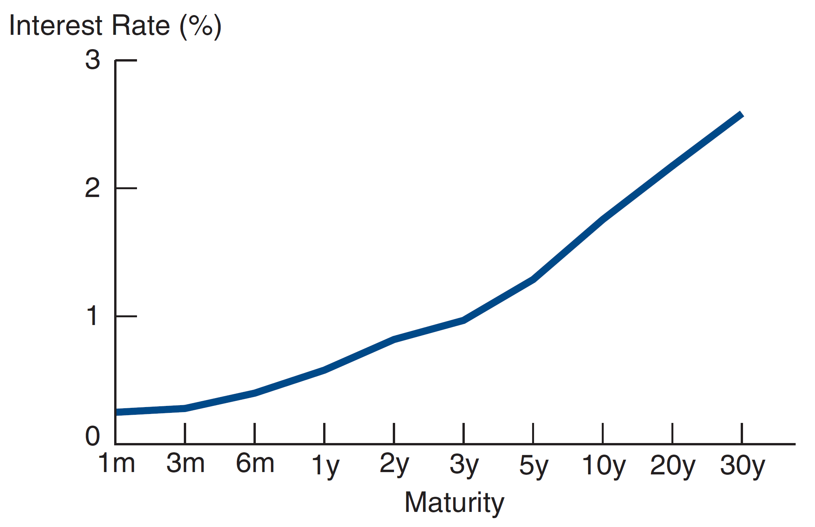
Following the News: The Yield Curve

Slide 27
Term Structure Facts to Be Explained
Besides explaining the shape of the yield curve, a good
theory must explain why:
Interest rates for different maturities move together. We see this on the next slide.

Slide 28
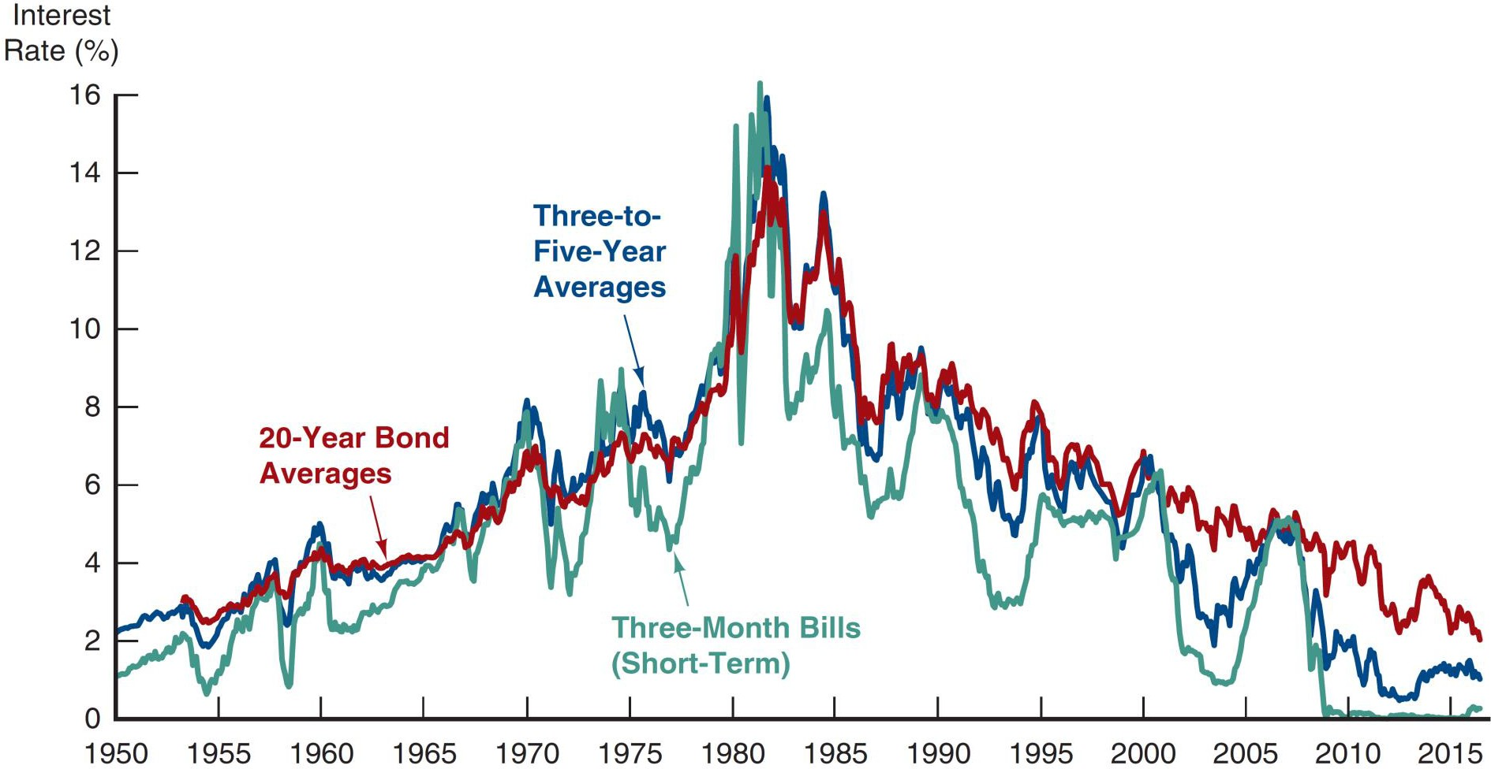
Figure 5.4 Movements over Time of Interest Rates on U.S. Government Bonds with Different Maturities
Source: Federal Reserve Bank of St. Louis, FRED database, https://fred.stlouisfed.org/series/TB3MS; https://fred.stlouisfed.org/series/GS3; https://fred.stlouisfed.org/series/GS5; https://fred.stlouisfed.org/series/GS20: Yield curve, http://finance.yahoo.com/bonds.

Slide 29
Term Structure Facts to Be Explained
Besides explaining the shape of the yield curve, a good
theory must explain why:
Interest rates for different maturities move together.
Yield curves tend to have steep upward slope when short rates are low and a downward slope when short rates are high.
Yield curve is typically upward sloping.

Slide 30
Three Theories of Term Structure (Next week)
Expectations Theory
Market Segmentation Theory
Liquidity Premium Theory

Slide 31

Financial Markets and Institutions
Ninth Edition, Global Edition
Reading – Chapter 5 – How do Risk and Term Structure Affect Interest Rates

